Slide 1
2021 NFL Fantasy Football Analysis
Seth Mitchem

Slide 2
Fantasy Football Facts
As of 2018, there were 60 million people playing fantasy football – Forbes estimated that this number has grown consistently by 9% year over year
Fantasy football has a market of $18.6 billion which is $6 billion more than the annual revenue of the entire NFL
20% of all fantasy football participants are female

Slide 3
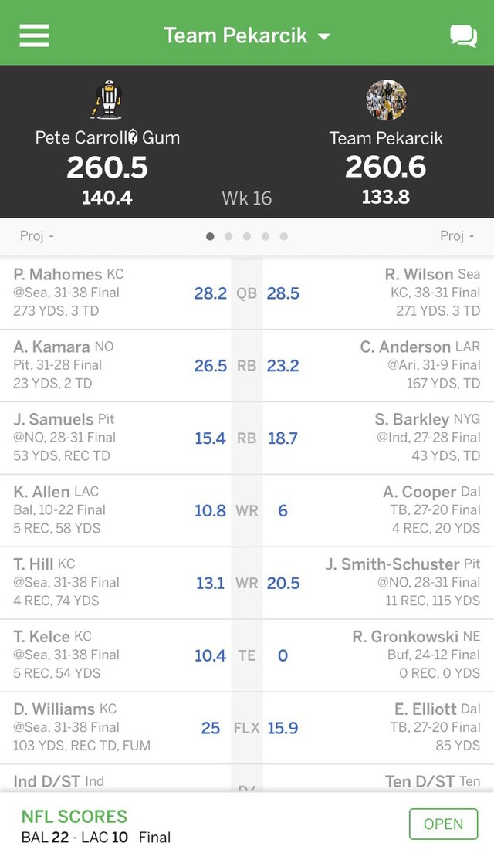
How Does it Work?
Before the regular season begins each year, each league holds a draft where you create a virtual roster of real NFL players. You then compete against other people’s rosters based on the stats of the players in real games.

Slide 4
PPR Scoring System
Passing
Point Total
Passing TD | 4
25 Passing Yards | 1
2pt Conversion | 2
Interception | -2
Rushing
Rushing TD | 6
10 Rushing Yards | 1
2pt Conversion | 2
Receiving
Receiving TD | 6
Reception | 1
10 Receiving Yards | 1

Slide 5
What Makes a Good Fantasy Football Team?
Consistency
Limited injuries
Players in a high volume offense

Slide 6
How I Calculated my Consistency Rating
100 – ((Standard Deviation/Mean) * 100)

